Slide 1
To-Do App
From Team Michael
Team members: Michael Awwad

Slide 2
Scenario and Problem Statement
POV: You’re a college student with a packed schedule. You’re juggling:
Academis: assignments, exams, projects, and deadlines.
Extracurriculars: club meetings, volunteering, or sports practice
Personal Life: seeing friends and family, running errands, and personal upkeep tasks.
Work: part-time shifts that demand time and focus.
Balancing all of this can feel overwhelming, and it’s easy to forget or miss something important. That’s where the To-Do App comes in!
The goal is simple: help users organize their responsibilities effectively. By enabling task prioritization, grouping and management, the app provides a central hub to keep everything in order.

Slide 3
What the System Can Do
01
02
03
04
Add Tasks
Sort and Group Tasks
Users can create tasks with a name, due date, and priority level (from 1-5)
Tasks are grouped by their due dates and tasks are sorted by priority
Mark Tasks Complete
Manage Completed Tasks
Once a task is done, users can mark it complete and it’s moved to a separate page
Completed tasks can be restored to the pending tasks list and users can clear all completed tasks with one button

Slide 4
How I Built the System
Task
TaskManager
Main
Represents individual tasks
Handles task logic, such as storing, sorting, and moving tasks between lists
Creates the GUI and handles user interactions

Slide 5
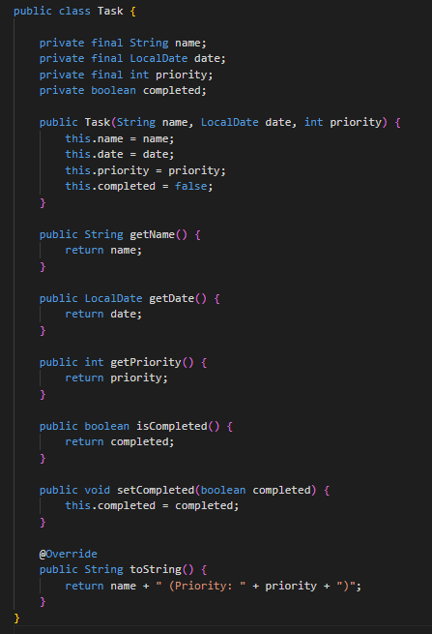
The Task Class
Stores task information:
String name: the tasks title
LocalDate date: when the task is due
int priority: how important the task is (1-5)
boolean isCompleted: whether the task is finished
Provides methods to interact with tasks, such as getters, setters, and a toString method to display tasks in the GUI
This class acts as the data model for the app. It was implemented first, as everything else depends on it

Slide 6
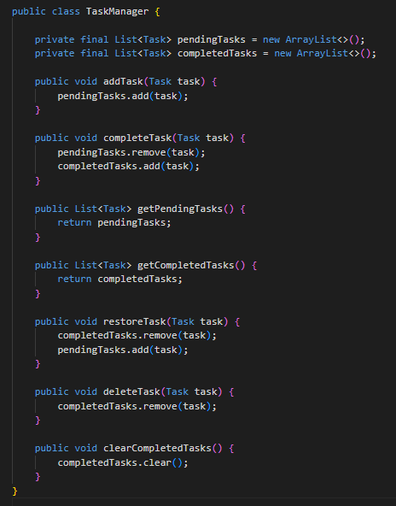
The TaskManager Class
Stores tasks:
pendingTasks: a list of tasks that are not complete, completedTasks: a list of tasks that have been marked complete.
The addTask method takes a Task object and adds it to the pendingTasks list.
The completeTask method moves a task from pendingTasks to completedTasks, updating its isCompleted status.
The deleteTask method removes a task from the completedTasks list.
Methods like getPendingTasks and getCompletedTasks return the current lists for display in the UI.

Slide 7
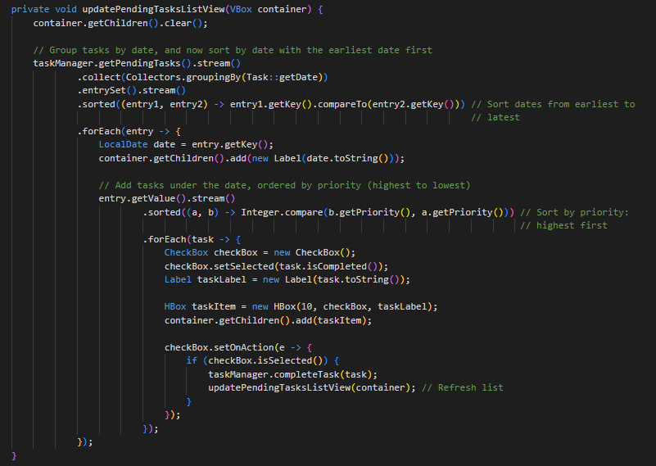
The Main Class
Uses JavaFX to create two scenes: one for pending tasks and another for completed tasks. Each scene is built with VBox containers to organize the layout.
Buttons for adding tasks, marking them complete, restoring them, and clearing all completed tasks. A DatePicker and Spinner for users to input due dates and priority.
Whenever a task is added, completed, or deleted the UI is refreshed to reflect the change.
Here’s an example of the method that updates the pending tasks view. This method dynamically organizes tasks by date and priority and updates the UI in real time

Slide 8
Debugging Process
Sorting Tasks by Date and Priority:
Issue: Task groups were initially sorted from farthest to nearest due date.
Solution: I fixed this by explicitly sorting groups in ascending order using Comparator.comparing. I also tested edge cases, such as tasks with the same due date but different priorities, to ensure they were displayed correctly.
Restore Button:
Issue: The restore button didn’t update the pending tasks list after restoring a task.
Solution: I added a call to updatePendingTasksListView immediately after restoring a task, ensuring the UI refreshed automatically.

Slide 9
What I Learned
Debugging
Debugging isn’t just fixing errors, it’s about understanding how and why the errors occur.
Planning
The importance of planning and breaking a project into smaller, manageable parts.
Object Oriented Programming Concepts
How to implement object oriented programming concepts effectively in a real world application.

Slide 10
Live Demo Time

